Slide 1
Demo day and your
90-day roadmap
What will I do in the next 90 days, and who will own it?
Applied AI and Automation | Session 12 of 12
KLAi Professional Learning | Jotham Martin Wambi
Notes:
Welcome to the last session. Start with your question from last time: which one number would make your sponsor say yes or no?
That number belongs in your presentation. Today you show what you built, hear what the room thinks, and plan the next ninety days with owners and dates. There are no scores and no judges. The aim is a real result and a real plan.

Slide 2



Today in one view: what you will leave with
By the end of today you will have
An eight-minute presentation of your own task, your result and your business case
Structured feedback from the room: one thing that worked, one question, one risk to watch
A 90-day roadmap with owners and dates, and the follow-up kit for the 30, 60 and 90 day check-ins
Notes:
Here is what you leave with. You present for eight minutes. You hear structured feedback: one thing that worked, one question, one risk to watch. And you build a ninety day roadmap with owners and dates, plus the follow-up kit that supports it. The seventy minute presentation block is the heart of the day.

Slide 3
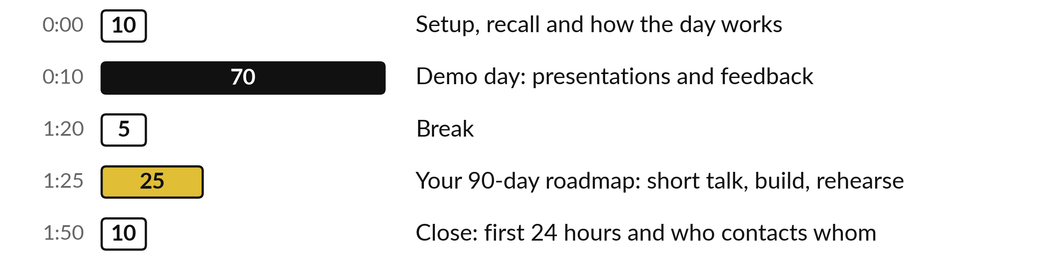
Today: presentations first, then your roadmap
70 minutes are presentations and feedback. 25 more are your own roadmap.
Notes:
Two parts take most of the day. After a short setup, seventy minutes go to presentations and feedback, eight minutes each plus questions. After the break, twenty-five minutes build your roadmap and rehearse the five minute version. The last ten minutes cover your first 24 hours, a look back at Session 1 and who contacts whom.
If we run late, I keep the presentations and shorten the break.

Slide 4

A question from last time
1. What was your decision for your own task, and which number decided it?
Answer aloud first. Then we check together.
Notes:
One quick question from Session 11. Answer aloud first, and then we check together. It is a warm-up to bring last time back.
Question one. What was your decision for your own task, and which number decided it? Take a moment.
A good answer is this. Go, revise or stop, with one number such as the 12-month net after the haircut or the review minutes.
If an answer was missing, your own task card or last workbook page has it. Now to today.

Slide 5



Words we use today
Word | What it means
Demo day | A short presentation of what you built and what it achieved, followed by questions.
Roadmap | Dated actions, each with one owner and one measure, for the next 90 days.
Owner | The one person who answers for an action or an automation.
Sponsor | The person who owns the result and asks for the decision.
Check-in | A short report at day 30, 60 and 90, using the Check-in Form and the Results Tracker.
Notes:
Five words for today. I give the plain meaning of each, and we use every one of them before the end of the session.
Demo day. A short presentation of what you built and what it achieved, followed by questions.
Roadmap. Dated actions, each with one owner and one measure, for the next 90 days.
Owner. The one person who answers for an action or an automation.
Sponsor. The person who owns the result and asks for the decision.
Check-in. A short report at day 30, 60 and 90, using the Check-in Form and the Results Tracker.

Slide 6
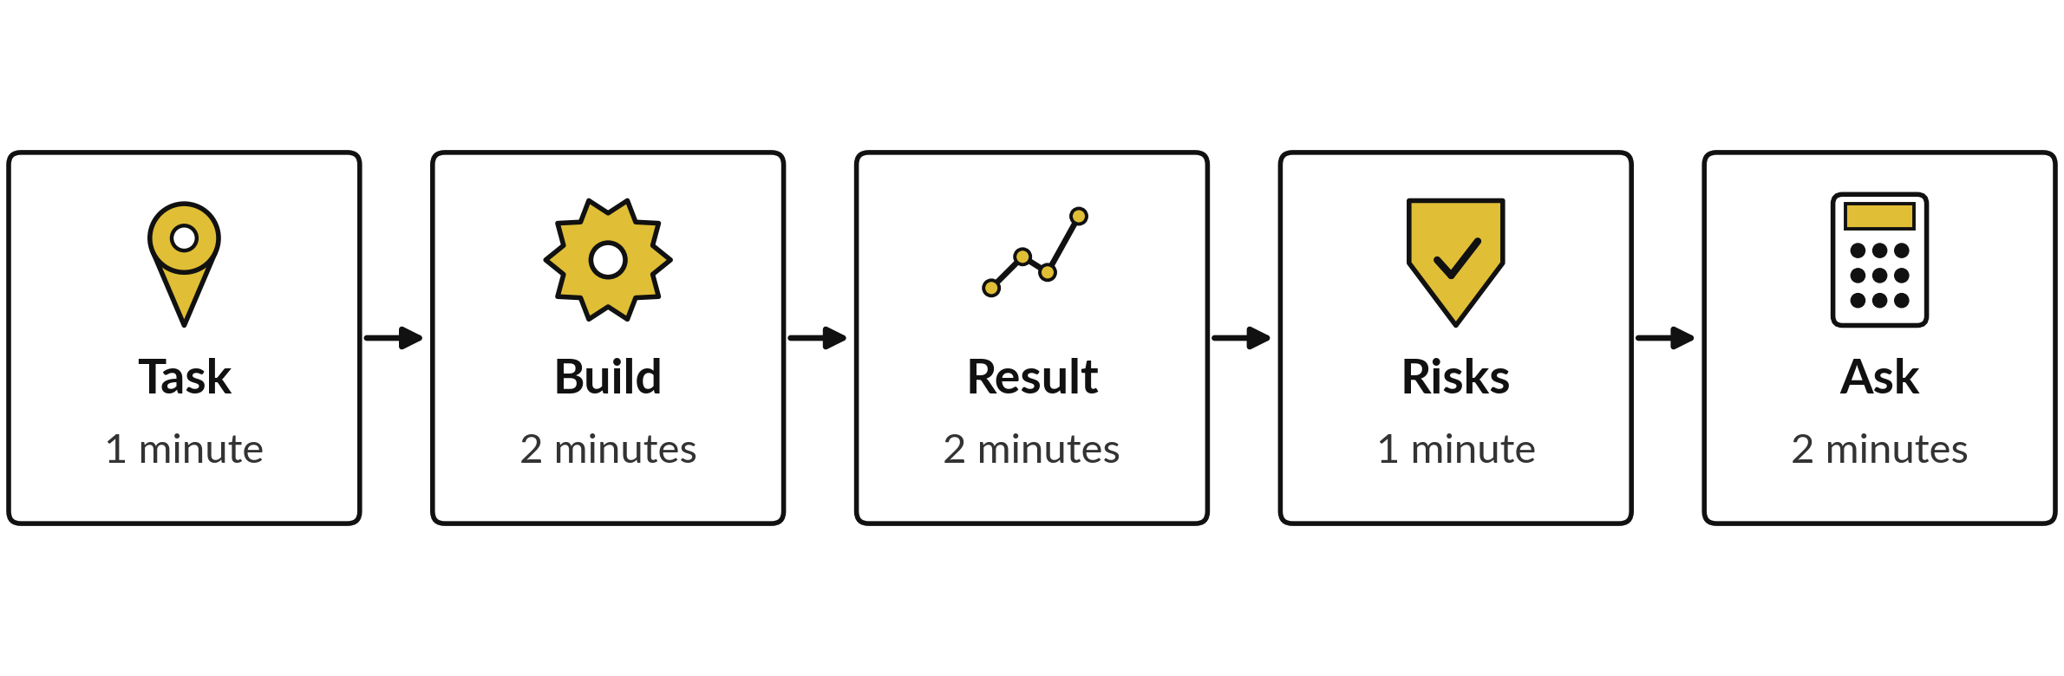
Eight minutes, five parts: the
shape of your presentation
Task and baseline. What you built. Plan beside measured result. Risks and policy. Business case and ask.
Notes:
This is the shape of your eight minutes. One minute on the task and its baseline. Two minutes on what you built and who owns it. Two minutes on the result: show your plan beside what you measured, and say why they differ. One minute on the risks and the policy points.
Two minutes on the business case and the ask. The ask is the most important part: what decision do you want, from whom?
Use the numbers from your workbook and your test log. A short, clear talk is easier to remember and to act on.

Slide 7
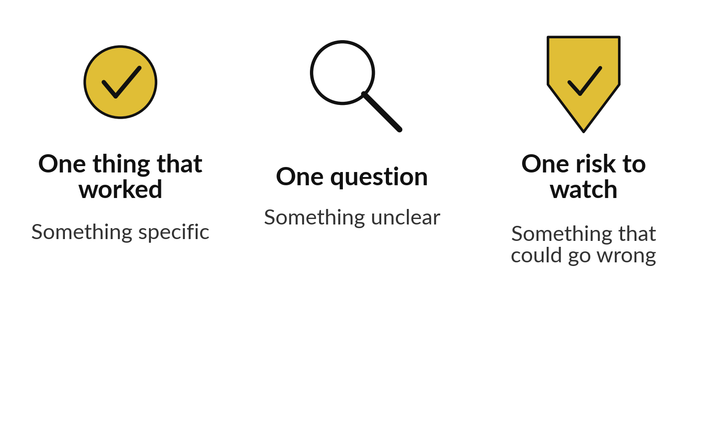
Feedback has three parts,
and nobody scores anybody
Each listener gives one of each, in plain words.
Write three lines on a card.
Say what you saw, with the number.
The presenter writes them down.
Notes:
Here is how the room gives feedback. Each listener gives three things, in plain words. One thing that worked, and be specific, for example the review step caught the wrong week. One question about something that was unclear. One risk to watch over the next ninety days. Nobody gives a score.
The presenter writes the three lines down and adds the useful ones to the roadmap. With one learner, a guest such as a colleague and I play the panel and give the same three.

Slide 8
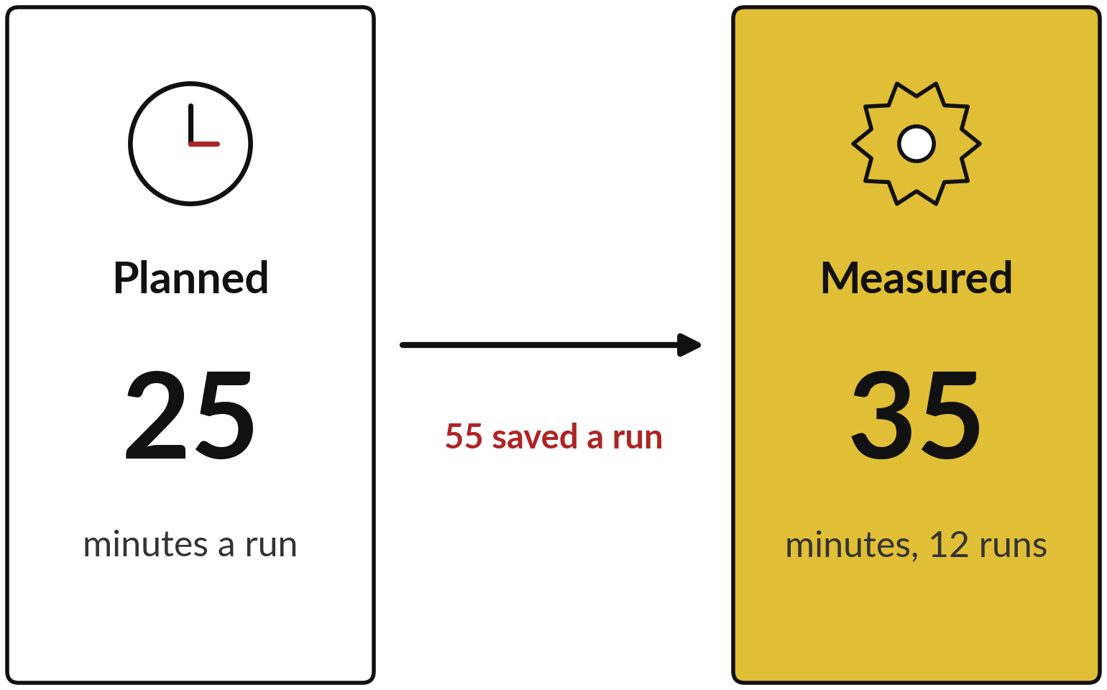
Peter planned 25 minutes a run and measured 35
Plan against measurement, from Peter Okello at NVF (fictional).
Task: Monday email, 90 minutes by hand.
Risk: one draft went to the wrong person.
Ask: UGX 600,000 and 30 hours for invoice checking.
Notes:
Here is a finished example from the case company. Peter Okello is the Sales Manager. The task is the Monday sales email: ninety minutes by hand, with four in ten containing an error. Peter says: "I planned 25 minutes. Measured over twelve runs it was 35, because checking took longer.
That is 55 minutes saved a run, 11 hours in all." He shows the plan next to the measurement and says why they differ. That is the habit I want from you. Then the risk: one draft went to the wrong person, so drafts now go to the owner only.
Then the ask: UGX 600,000 and thirty hours of the Finance Manager's time for invoice checking.

Slide 9



Track three numbers every month
and report them the same way
Number | Where you record it | How you report it
Hours saved | Results Tracker: runs, minutes by hand, planned and measured minutes | Cumulative hours, on the Check-in Form
Errors found | Results Tracker: errors caught and errors that got through | Both counts, every month
Incidents | Results Tracker: Incidents and Notes columns | What happened, what changed, who was told
One row for each automation each month. Delete the grey example rows first.
Notes:
Three numbers are enough. Hours saved: the Results Tracker works it out from runs, baseline minutes and the minutes now per run, measured with review included. It also holds your planned minutes, so you can put plan beside measurement as Peter did. Errors found: record the errors caught before release and, separately, the errors that got through.
Incidents: anything that went wrong, such as a draft sent to the wrong person. Write it in the Incidents and Notes columns and in question three of the Check-in Form. Report all three the same way every month, so the trend is visible. Delete the grey example rows before you start.

Slide 10
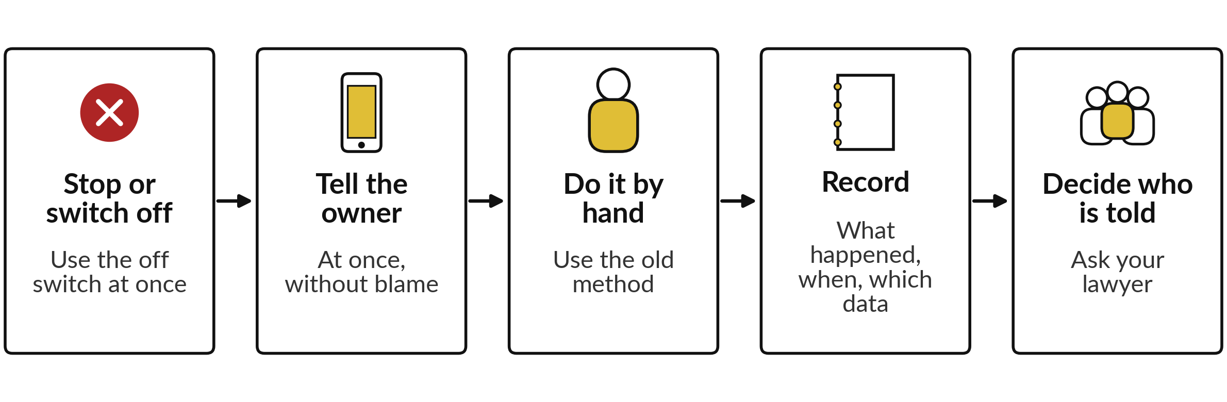
When something goes
wrong: five steps, then fix it
Then fix the cause, test again and update the policy and the boundary sheet.
Notes:
This is the same list you saw in Session 9, and it belongs in your presentation under risks. Stop or switch off, using the off switch. Tell the owner of the automation at once, and the sponsor the same day. Do the task by hand with the old method, so the work still gets done.
Record what happened in the Incidents column and in the check-in. Decide who must be told, and ask your lawyer about personal data. Then fix the cause, test again, and update the boundary sheet before you turn it back on. At NVF a draft once went to the wrong person, and the fix was to create drafts for the owner only.

Slide 11
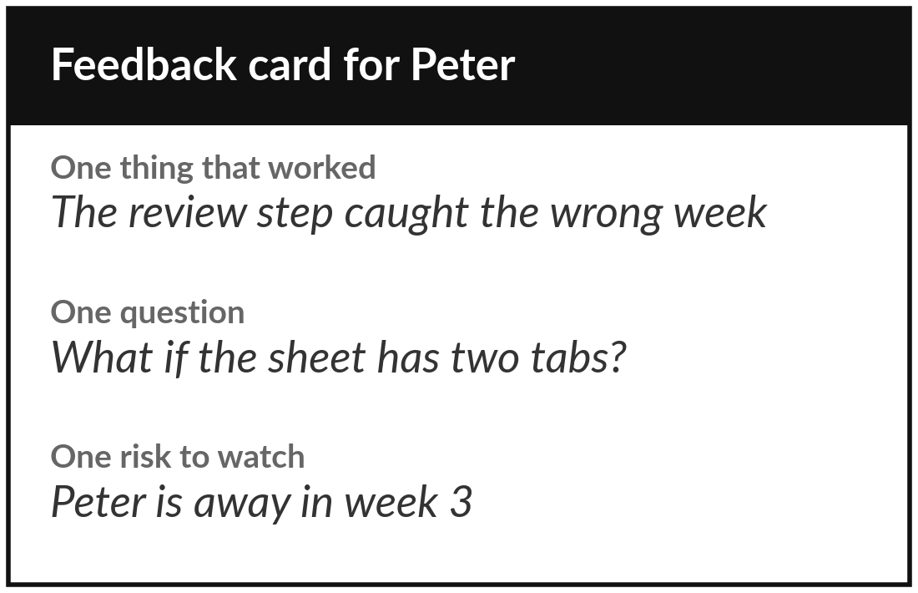
Demo day: present your
task, your result and your ask
8 minutes
Your own company task
Present in eight minutes, then take questions.
Show the task, the baseline and what you built.
Show your plan next to your measured result.
Name the risks, the policy points and your ask.
Listeners give three lines each. You write them down.
You keep: A presented result and written feedback to use in your roadmap.
Notes:
Now demo day. Each of you has eight minutes, then questions. Use the five parts: the task and baseline, what you built, your plan beside your measured result, the risks and policy points, and the business case with your ask. I keep time and hold up a card at one minute left.
Listeners write their three feedback lines while you talk and read them after. If your result is below your plan, say so and say why, as Peter did. A clear account of a mistake and its fix is more convincing than a perfect story. Who would like to go first?

Slide 12
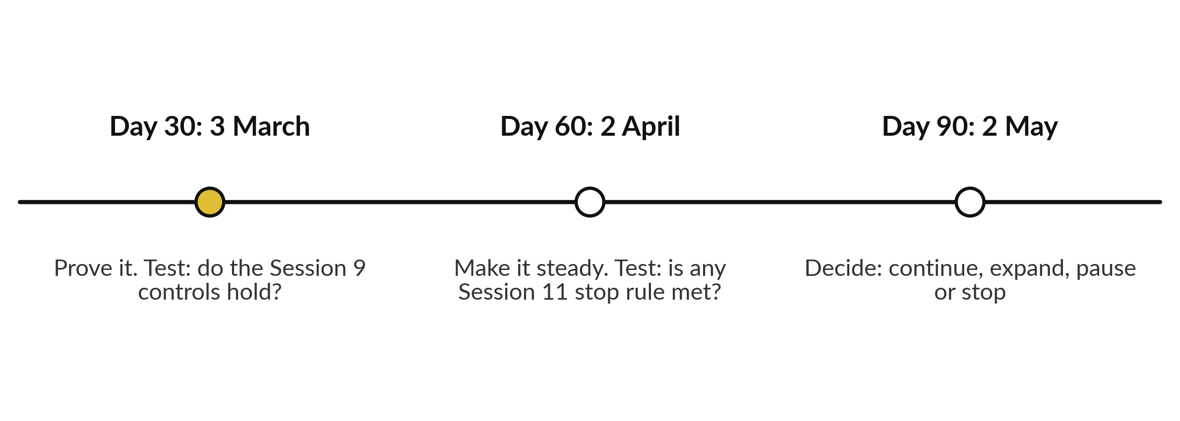
A 90-day plan starting 1 February 2027
NVF example. Choose your own start date.
Notes:
Welcome back. Your roadmap has three blocks of thirty days. In the Nile Valley Foods example the plan starts on 1 February 2027, so day 30 is 3 March, day 60 is 2 April and day 90 is 2 May. Choose your own start date and count from it.
Days one to thirty: prove it. Run, log and check every result. At day 30 the review test is your Session 9 controls: is each reviewer, owner and off switch really in place?
Days thirty-one to sixty: make it steady. At day 60 the test is your Session 11 stop rules: is any one of them met?
Days sixty-one to ninety: report the results and decide. Three to six actions in each block is plenty.

Slide 13
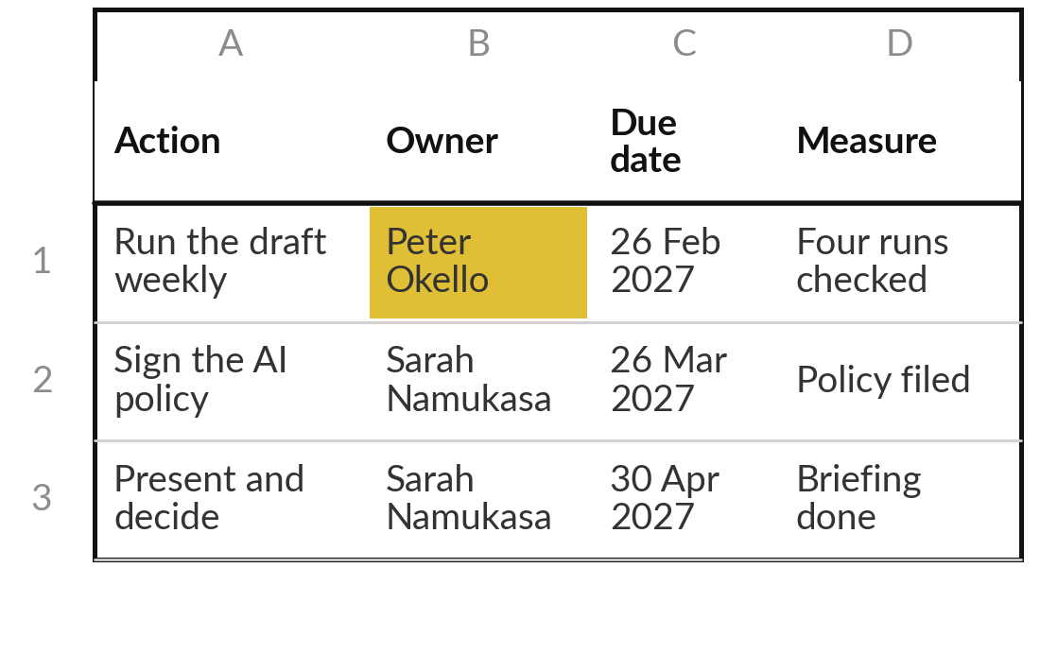
Practice: build your 90-day roadmap
12 minutes
Your own company task
Fill the Roadmap, Decisions and Risks sheets for your own task.
Open 90-Day Roadmap.xlsx. Write three to six actions in each block.
Give every action one owner, one due date and one measure.
Add the day 30, 60 and 90 check-ins with their review test.
List the decisions and the risks to the plan, including one about people.
You keep: A roadmap with owners and dates, and the decisions and risks lists.
Notes:
Take twelve minutes. Open the ninety day roadmap and write your start date. Write three to six actions in each block, and mark the grey example rows as examples. Every action needs one owner, a due date in your diary and a measure that someone else could check.
Add the three check-in dates, with the review test for each. Then fill the decisions list: who decides, and by when. Then the risks to the plan itself, including at least one about people, such as the owner being away. Use the feedback you wrote down earlier. I will check that each action has exactly one owner.

Slide 14
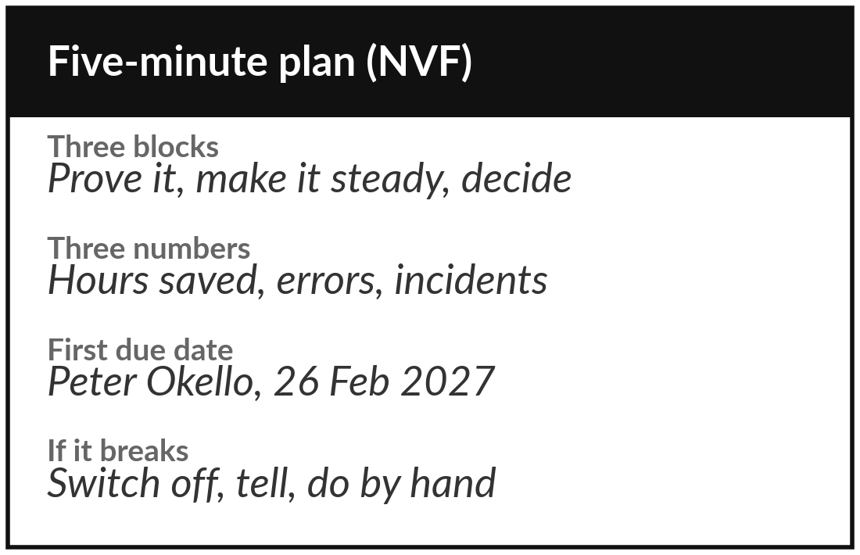
Practice: rehearse the
five-minute version of your plan
8 minutes
Your own company task
Say your roadmap aloud in five minutes, as you would to your sponsor.
Say the three blocks and the three numbers you will track.
Say who owns each action and the first due date.
Say what you will do if it breaks.
Swap with another learner or with me, and note one fix.
You keep: A five-minute plan you can give to your sponsor.
Notes:
Eight minutes. Say your roadmap aloud in five minutes, as if to your sponsor. Three blocks. The three numbers you will track. Who owns each action and the first due date. What you will do if the automation breaks. Then swap with another learner, or with me, and listen to theirs.
Note one fix for yours. If you stumble, a number may be missing or an owner unclear. Fix the roadmap itself, and the speech follows. A plan you can say in five minutes is a plan you can run.

Slide 15



Decision: what will you do in your first 24 hours?
Which action will you take within 24 hours?
Run it once
Tell people
Book the dates
Run the automation with the owner watching, and log the result.
Brief the people who check results and the sponsor, and name the owner.
Put the 30, 60 and 90 day check-ins in the diary.
Write the action, the owner and tomorrow's date at the top of the roadmap.
Notes:
One decision before we close. What will you do in your first twenty-four hours?
You could run the automation once with the owner watching and log the result. You could tell the people who will check results and your sponsor, and name the owner. Or you could put the thirty, sixty and ninety day check-ins in the diary. Pick the one that is most likely to get done.
Write the action, the owner and tomorrow's date at the top of the roadmap. A plan with a first step in the diary has a much better chance.

Slide 16
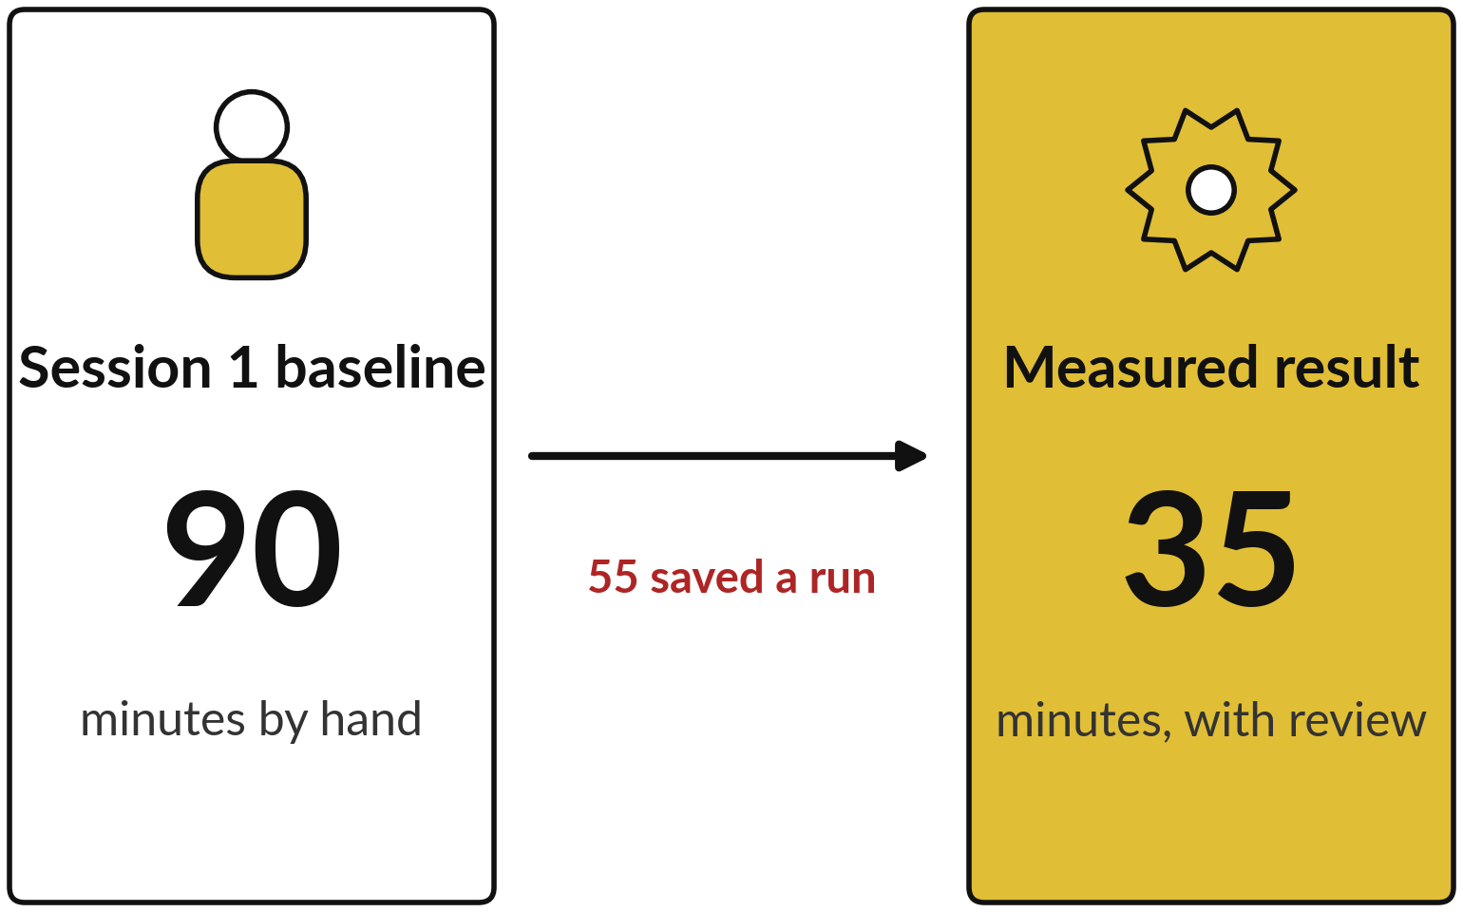
Look back at your Session 1
baseline, then close the round
Read your baseline aloud, then your own measured result.
Say the gap in minutes or errors.
One thing you will stop doing.
One thing you will start.
Notes:
We finish with a round. Open your Session 1 task card and read your baseline aloud: the minutes and the errors before any automation. Then say your measured result beside it. At Nile Valley Foods the gap is 90 minutes by hand against 35 measured, which is 55 saved a run.
Then say one thing you will stop doing and one thing you will start. Small is fine: stop copying totals by hand, start a weekly check of the log. You can now build a workflow, measure whether it helps, question a vendor, and start and supervise a small pilot.
Thank you for twelve sessions of real work on your own company.

Slide 17
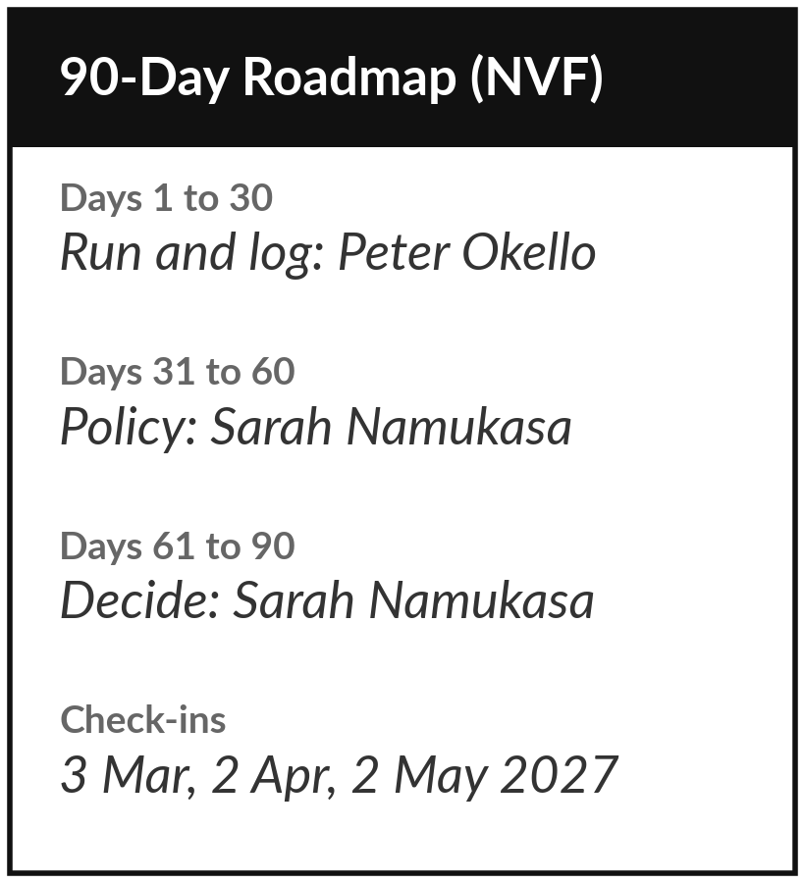
Your first 24 hours and who contacts whom
What you keep from today
Your 90-day roadmap and the follow-up kit (Check-in Form, Results Tracker, Sponsor Briefing), with the dates filled in.
What happens next
The 30, 60 and 90 day check-ins. I follow up by message or call, and you return the Check-in Form and the Results Tracker.
Notes:
These are your first 24 hours and who contacts whom. Within 24 hours, do your day-one action and write it at the top of the roadmap. Keep the roadmap and the follow-up kit together in one folder, with your three check-in dates in your diary. I contact you by message or call at day 30, day 60 and day 90, and you return the Check-in Form and the Results Tracker.
If something breaks before then, switch it off, tell your owner and your sponsor, and message me when you can. Thank you for your work over these twelve sessions.

